Slide 1

Python Tsunami
Local Installation

Slide 2




Local Installation Options
JupyterLab
Visual Studio Code (VSC)
PyCharm
Spyder
https://code.visualstudio.com/

Slide 3
Visual Studio Code
Free + open source solution from Microsoft
Many programming languages
Github integration
Easy to install
https://code.visualstudio.com/

Slide 4
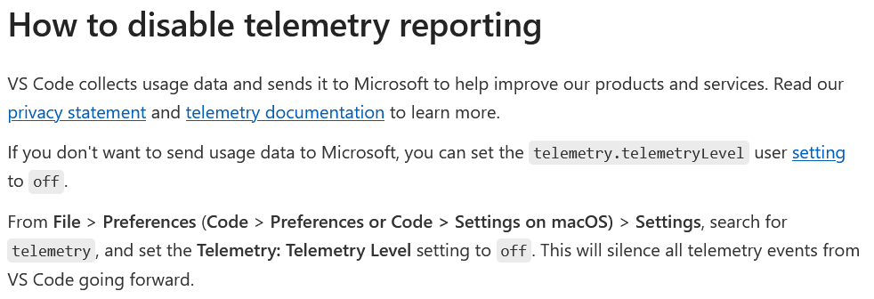
Visual Studio Code
Disable telemetry if you would not like Microsoft collecting your data!

Slide 5
Installation

Slide 6


Installing Python and Libraries - OS X & Ubuntu
Install Python via system package manager or official installer:
homebrew: https://docs.brew.sh/Homebrew-and-Python
apt-get: https://help.ubuntu.com/community/AptGet/Howto
Install Visual Studio Code:
https://code.visualstudio.com/docs/setup/mac
Add the official Python & Jupyter extension in Visual studio code
Set up a Python environment for reproducibility (venv or Conda)
Install required libraries
Pip / Pip3: https://www.activestate.com/resources/quick-reads/how-to-install-and-use-pip3/
Conda: https://docs.conda.io/projects/conda/en/stable/user-guide/concepts/installing-with-conda.html

Slide 7

Installing Python and Libraries - Windows
Install Python for Windows
Use the official Python installer: https://www.python.org/downloads/windows/
Ensure Python is added to system PATH (ask chatGPT)
Install Visual Studio Code:
https://code.visualstudio.com/docs/setup/windows
Add the official Python & Jupyter extension to VS code
Set up a Python environment for reproducibility (venv or Conda)
Install required libraries
Pip: https://packaging.python.org/en/latest/tutorials/installing-packages/
Conda: https://docs.conda.io/projects/conda/en/stable/user-guide/concepts/installing-with-conda.html

Slide 8
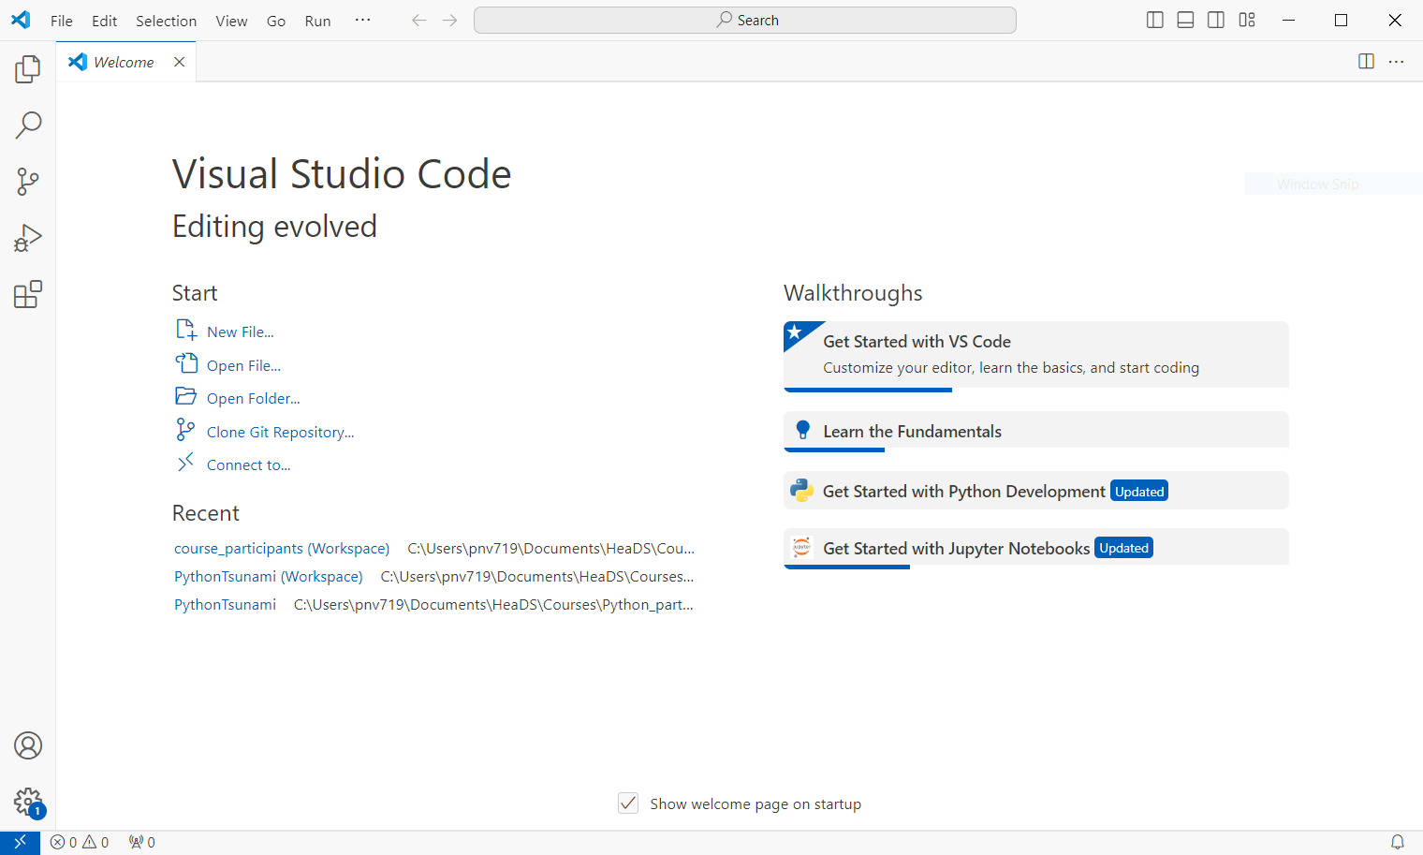
Start Up VS code
When you open a python script it will help you find an interpreter

Slide 9
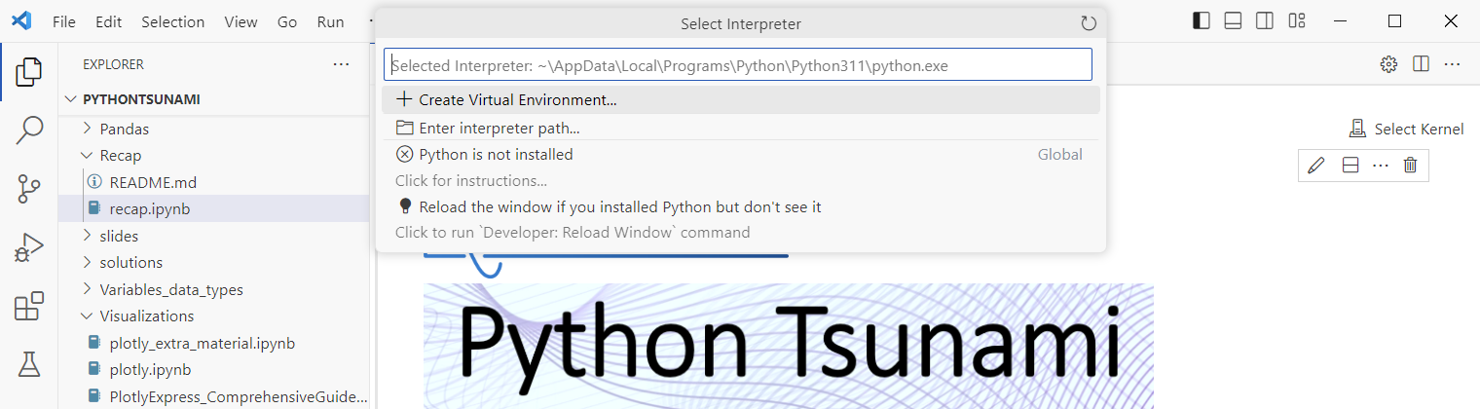
Add Python Extension in VS code
Windows: Microsoft Store or global install https://www.python.org/downloads/windows/
Mac: App Store or command line
Linux systems: Command line

Slide 10
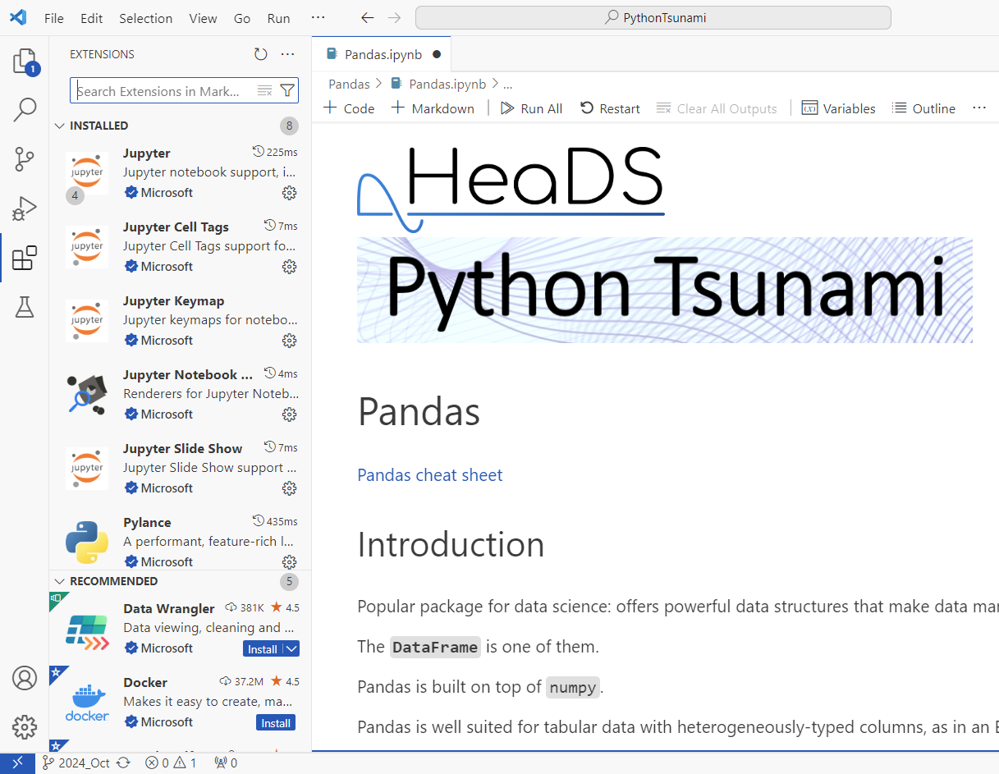
Add Python Extension in VS code
OR check ‘extensions’
As you can see, I also got Jupyter ect. because I opened an ipython notebook.

Slide 11
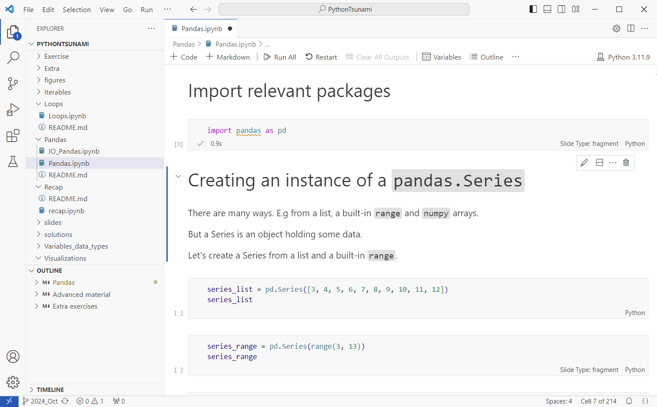
Jupyter Notebook
VS code can open ipython notebooks:
Operate as in colab
Code cells and text cells
Run cells with run button or shift+enter
Output appears below cell

Slide 12
Github Integration

Slide 13
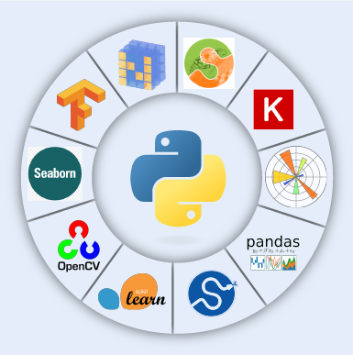
Packages
Packages are also called libraries.
They are bundles of code that contain a certain functionality.
You have already used packages:
import pandas as pd
import seaborn as sns
You’ll need to have a local install of the package before you can load and use it.

Slide 14
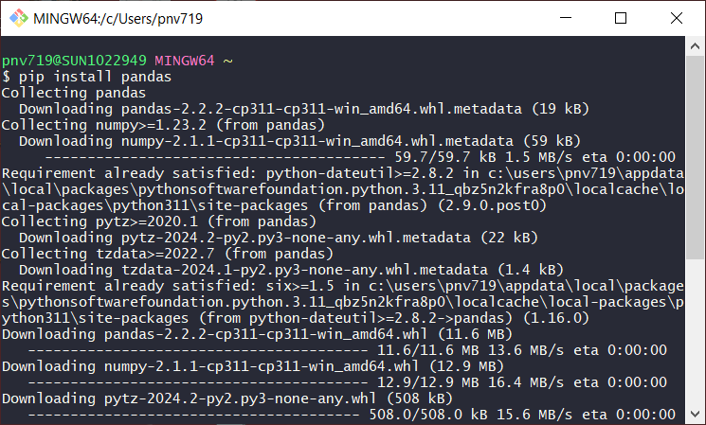
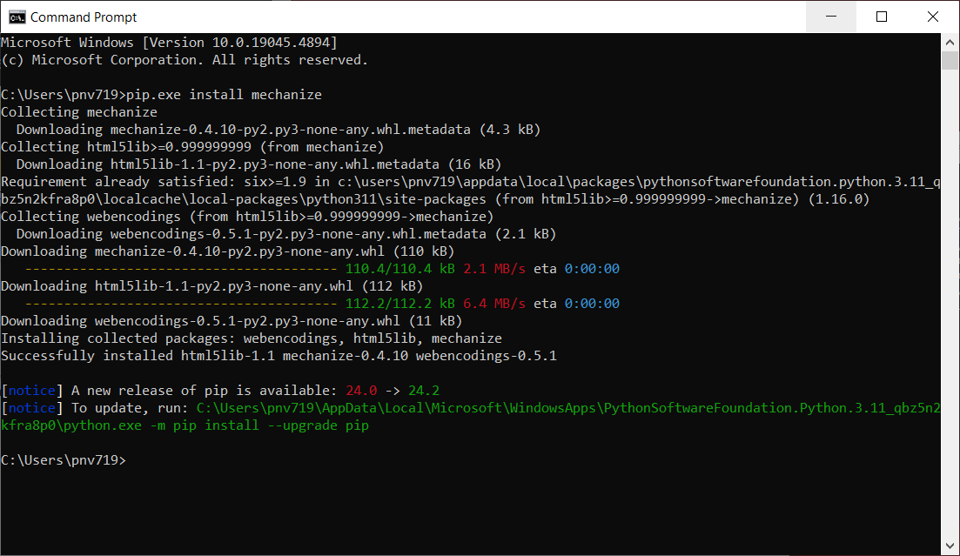
Installing Python and Libraries
Option 1: Pip + any bash terminal
Option 2: Pip in powershell
Some systems have pip2 or pip3 instead of pip.

Slide 15
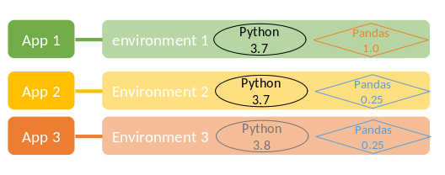

Conda Environment
Conda is an open source package & environment management system.
Softwares exist as conda packages, you can use conda to install them and their dependencies.
An environment is a specific combination of packages in a specific version.
PROS:
Comprehensive, many options
Environment management
Well documented
Can be overwhelming
Some channels are not free
I’m looking for someone to share in an adventure
CONS:

Slide 16
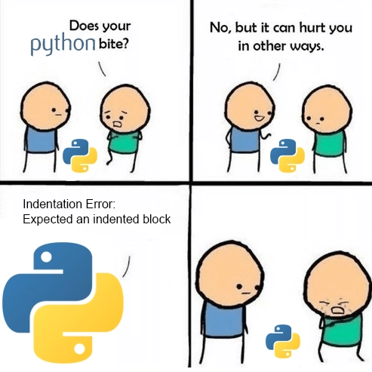
Dataset Exercise
I’m looking for someone to share in an adventure

